Slide 1

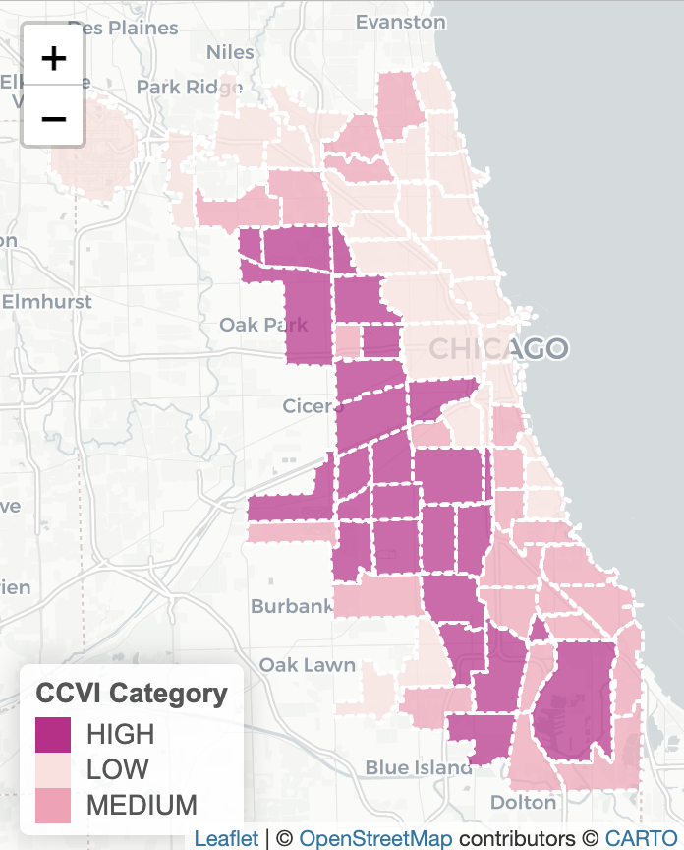
In the space below to copy/paste/insert a custom version (new color palette) of Figure 1 (map of CCVI Scores by Community Area) from the exercise.
GEO 3330 Sustainable Urban Transportation
Exercise #2: L Station Ridership Trends
Describe here any patterns you see in the map. Use data from the map to describe characteristics of at least one community located within each of the three CCVI categories.

Slide 2
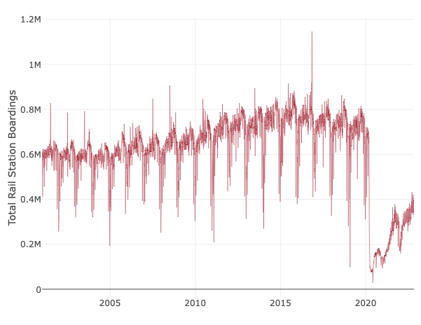
In the space below to copy/paste/insert Figure 2 or 3 from the exercise.
GEO 3330 Sustainable Urban Transportation
Exercise #2: L Station Ridership Trends
What other factors may explain ridership over this period? Draw from the daily ridership plot to characterize ridership trends during the pandemic.
Figure 3 shows a steady boarding around 0.6-0.8M riders but this significantly changed due to the pandemic in 2020. This shows daily ridership so there may be lower numbers on weekends when people are not communing to work. Possibly the cold weather could influence when people would want to take the L. Daily ridership in 2020 hit an all time low but slowly increased from then on out.

Slide 3
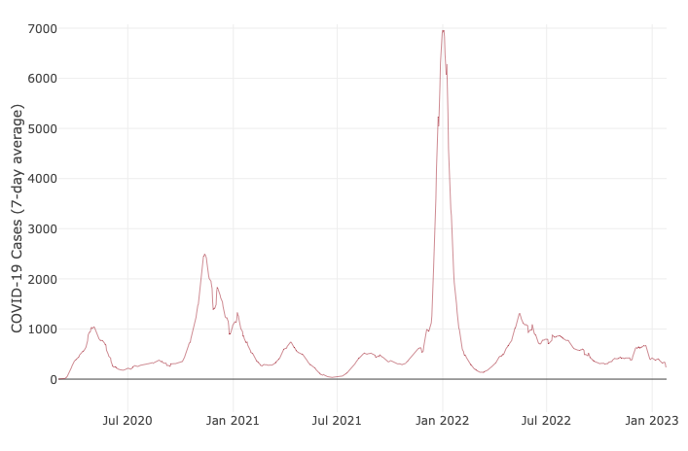
In the space below to copy/paste/insert Figure 4 from the exercise.
GEO 3330 Sustainable Urban Transportation
Exercise #2: L Station Ridership Trends
Are the waves and phases of the pandemic evident? Compare these pandemic phases to ridership trends over the same period. Do they appear to be related?
The waves do appear to be negatively correlated to CTA ridership. As the covid cases increase such as first in 2020 and then again in Jan 2022, CTA rides decrease during these times.

Slide 4
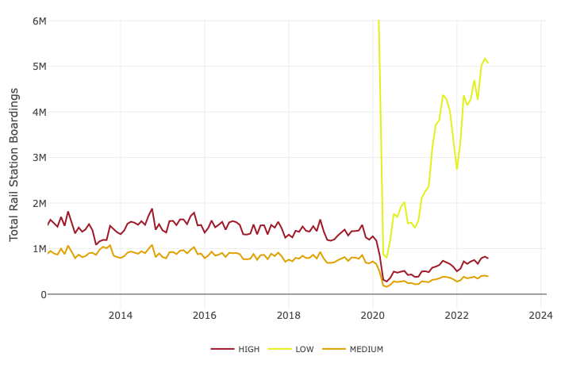
In the space below to copy/paste/insert Figure 5 or 6 from the exercise.
GEO 3330 Sustainable Urban Transportation
Exercise #2: L Station Ridership Trends
How does ridership vary with respect to station CCVI and line?
Here we see that the pandemic leveled the divide between ridership of low and high CCVI slightly. There is a smaller difference between high and low vulnerability after Covid which could mean that low vulnerable groups had the ability to use other forms of transportation more than high vulnerable groups so high and medium CCVI boardings were more necessary.

Slide 5
Summarize some potential short- and longer-term implications the pandemic has had on sustainable transportation and public transit ridership?
Ridership may stay below pre pandemic levels as people have become more aware about health and sanitary concerns. Also, more people have started to work from home so the number of commuters will stay below pre pandemic levels.
GEO 3330 Sustainable Urban Transportation
Exercise #2: L Station Ridership Trends
What strategies do you propose to help return transit to pre-pandemic levels?
While pre-pandemic levels may be dependent on the number of people that stay working from home, there could be a greater initiative to make transit safe and cleaner than before. Further, having trains be as reliable and run on the same schedule as pre-pandemic times will also allow for more people to trust and use transit.

